Slide 1
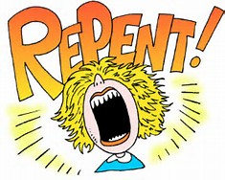

Slide 2
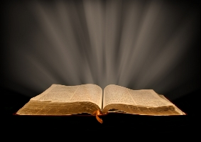
The Ten Most Misunderstood Words in the Bible

Slide 3
What is Repentance?
Who Needs to Repent?
When do you Repent?
Is Repentance Necessary for Salvation?

Slide 4
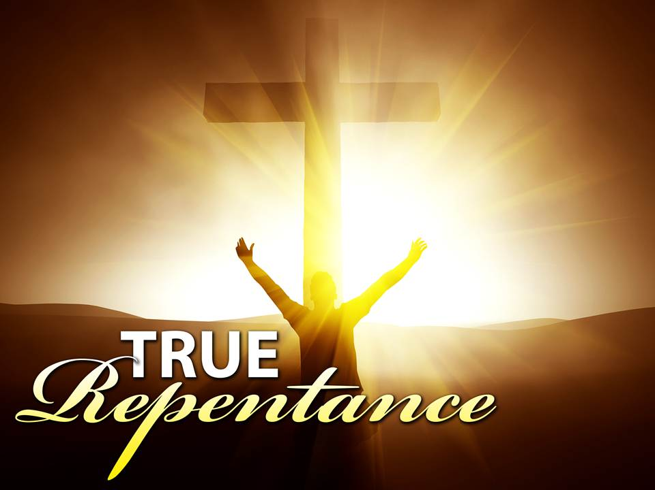
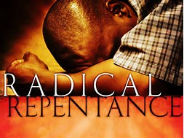
What is Repentance?

Slide 5
What is Repentance?

Slide 6
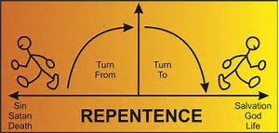
What is Repentance?

Slide 7
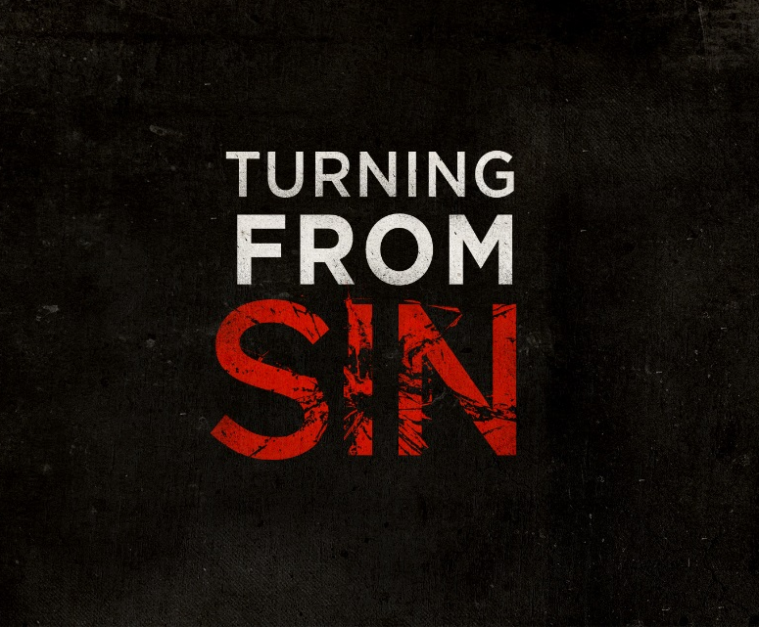
What is Repentance?

Slide 8
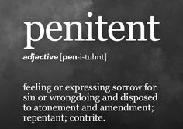
What is Repentance?

Slide 9
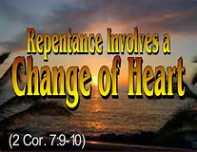
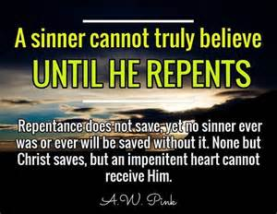
What is Repentance?

Slide 10
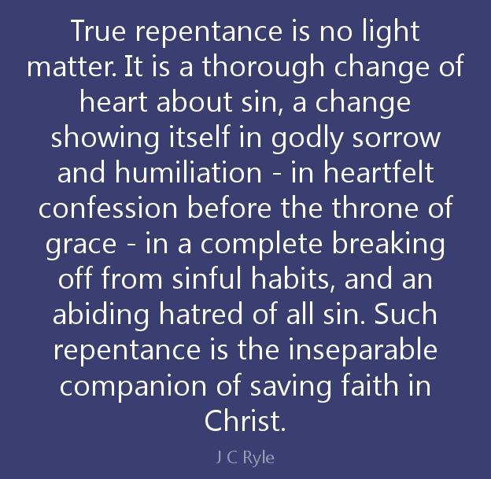
What is Repentance?

Slide 11
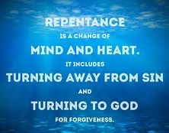
What is Repentance?

Slide 12
What is Repentance?
“metanoia” – “repentance”
“metanoeo” – “repent”
“meta - noia” –
“a change of mind”
“to reconsider”

Slide 13
What is Repentance?
“repentance” – 24x’s in NT
“repent” – 26x’s in NT
“believe” – 149x’s in NT
“faith” – 272x’s in NT

Slide 14
What is Repentance?
“repentance” – 17x’s in OT
“repent” – 22x’s in OT
“nacham” – “to sign” - 17x’s
“shuwb” – “to turn back”
270x’s in the OT

Slide 15
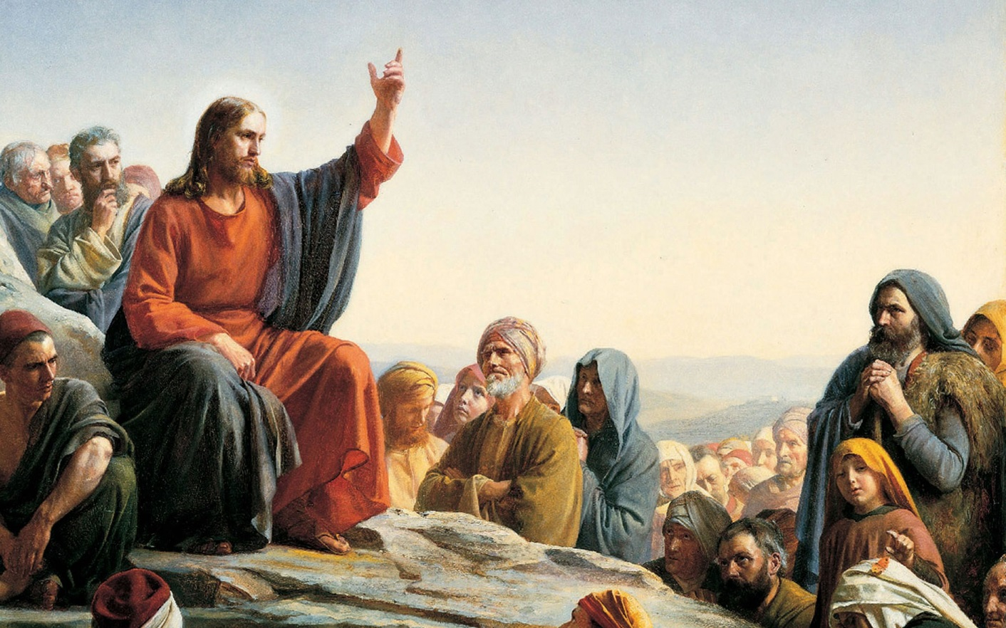
How Repentance is Used?
“How did Jesus use repentance?

Slide 16
How Repentance is Used?
“The men of Nineveh will rise up in the judgment with this generation and condemn it, because they repented at the preaching of Jonah...” (Matthew 12:41)

Slide 17
How Repentance is Used?
“So the people of Nineveh believed God, proclaimed a fast, and put on sackcloth…”
“Then God saw their works, that they turned from their evil way…”. (Jonah 3:1-5)

Slide 18
How Repentance is Used?
The Ninevites clearly repented when they turned from their evil ways, to avoid destruction of their city. Their repentance was not a change of mind about themselves and God.

Slide 19
How Repentance is Used?
Jesus was rebuking that generation of Jews for not turning from their sins – repenting. The result would be the destruction of their lives and their city.

Slide 20
How Repentance is Used?
A “turning from sins” seems to fit every New Testament use of repentance, for the purpose of avoiding temporal punishment, “the wrath of God”.

Slide 21
How Repentance is Used?
“Both in the OT and in the NT repentance is turning from sins. It is never simply a change of mind about oneself (recognizing one is a sinner) or a change of mind about Christ (recognizing He is the Savior).” p. 108

Slide 22
How Repentance is Used?
Repentance should be distinguished from the recognition that one is a sinner or the confession of sin.
Acknowledgment of sin is a prerequisite for believing in Jesus for eternal life.

Slide 23
How Repentance is Used?
Other Prerequisite:
Acknowledgement that Jesus is the Savior and the LORD.
Acknowledgment that one cannot be saved by the works of the Law, or any good work.

Slide 24
How Repentance is Used?
In Acts 19:4, Paul called the baptism of John a “baptism of repentance” which was designed to call the Jews “to first give up self-righteous attitude and recognize his sinfulness and need for forgiveness”. (Hodge, Harmony with God, 117-19)

Slide 25
How Repentance is Used?
Repentance should be distinguished from “Conversion”, which could be a change of mind concerning one sinful state and/or the person of Christ (His divinity).

Slide 26
How Repentance is Used?
Paul heard, how the Thessalonians had “turned to God from idols to serve the living and true God…” (1 Thessalonians 1:9)

Slide 27
How Repentance is Used?
Repentance is not necessary for salvation. It is not a condition for receiving eternal
life.

Slide 28
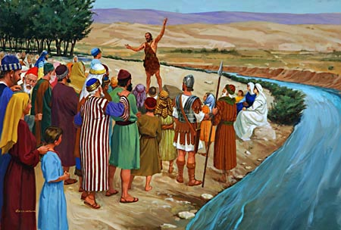
Biblical Repentance
“John came baptizing in the wilderness and preaching a baptism of repentance for the remission of sins.”
(Mark 1:4-5)

Slide 29
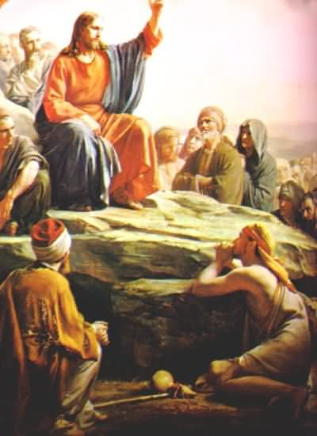
Biblical Repentance
“Repent, and believe in the gospel.” (Mark 1:15)

Slide 30
Biblical Repentance
“Now after John was put in prison, Jesus came to Galilee, preaching the gospel of the kingdom of God, and saying, ‘The time is fulfilled, and the kingdom of God is at hand. Repent, and believe in the gospel.” (Mark 1:14-15)

Slide 31
Repentance in the OT
“But if a wicked man turns from all his sins which he has committed, keeps all My statutes, and does what is lawful and right, he shall surely live; he shall not die…” (Ezekiel 18:21f)

Slide 32
Repentance in the OT
“Repent, and turn from all your transgressions, so that iniquity will not be your ruin… I have no pleasure in the death of one who dies, says the Lord God. ‘Therefore turn and live!.” (Ezekiel 18:30-32)

Slide 33
Biblical Repentance
John the Baptist was sent to prepare the nation of Israel for the coming of the Messiah. He proclaimed, “Repent for the kingdom of heaven is at hand!” (Matthew 3:2)

Slide 34
Biblical Repentance
“Behold, I will send you Elijah the prophet before the coming of the great and dreadful day of the LORD. And he will turn the hearts of the fathers to the children, and the hearts of the children to their fathers, Lest I come and strike the earth with a curse.”(Malachi 4:5-6)

Slide 35
Biblical Repentance
The nation needed to turn from their sins in order for the Messiah to establish His earthly Kingdom, and to be saved from Gentile bondage.

Slide 36
Biblical Repentance
Their were two conditions for that generation of Jews to be saved (Gentile bondage) and receive the Kingdom - repent and believe in the Messiah. And these conditions still stand for even a future generation. (Romans 11:26)

Slide 37
Biblical Repentance
“I tell you, no; but unless you repent you will all likewise perish.” (Luke 13:1-5)

Slide 38
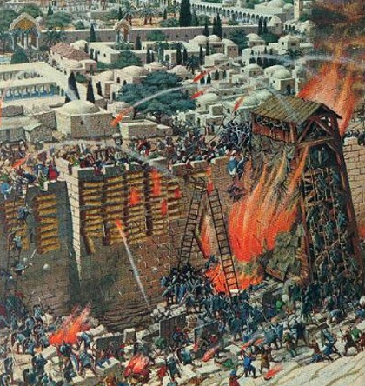
Biblical Repentance
Unless that generation of Jews repented they would likewise perish, that is die at
the hands of the
Romans as well.

Slide 39
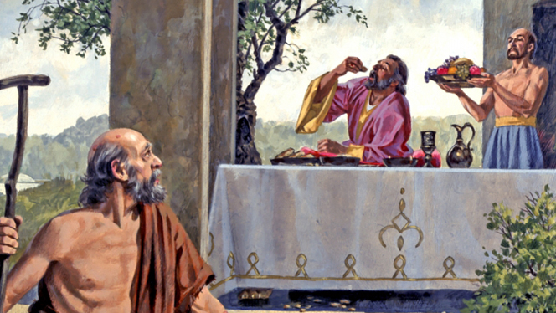
Biblical Repentance
Lazarus and the Rich Man
Luke 16:19-31

Slide 40
Biblical Repentance
“Abraham said to him, ‘They have Moses and the prophets; let them hear them.' And he said, ‘No, father Abraham; but if one goes to them from the dead, they will repent.’ But he said to him, ‘If they do not hear Moses and the prophets, neither will they be persuaded though one rise from the dead.” (13:29-31)

Slide 41
Biblical Repentance
“Thus it is written, and thus it was necessary for the Christ to suffer and to rise from the dead the third day, and that repentance and remission of sins should be preached in His name to all nations, beginning at Jerusalem.” (Luke 24:46-47)

Slide 42
Biblical Repentance
The Great Commission was primarily a charge to “make disciples”, not evangelism.
According to 1 John 1:9 even believers need ongoing forgiveness for the remission of sins.

Slide 43
Biblical Repentance
Even believers may need to repent in order to avoid the wrath of God and temporal punishment, even possible premature death.

Slide 44
Biblical Repentance
“Then Peter said to them, ‘Repent, and let every one of you be baptized in the name of Jesus Christ for the remission of sins; and you shall receive the gift of the Holy Spirit.” (Acts 2:38)

Slide 45
Biblical Repentance
Acts 2:38 is not teaching that repentance and baptism are conditions for receiving everlasting life!
What they wanted to know was what they need to do in order to avoid the quilt of killing their Messiah.

Slide 46
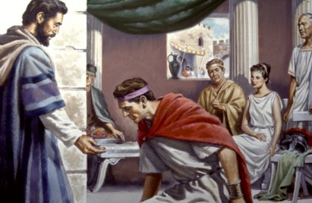
Biblical Repentance
“God has also granted to the Gentiles repentance to life.” (Acts 11:18)

Slide 47
Biblical Repentance
It does not say that this is repentance to everlasting life.
Hodges suggests it means that the Gentiles have enter into the same “life experience”, the Christian life.

Slide 48
Biblical Repentance
It could mean that repentance, turning from sins, leads to everlasting life. Repentance helps an unbeliever come to faith.
Repentance restores a rebellious believer to fellowship with the Father.

Slide 49
Biblical Repentance
“Or do you despise the riches of His goodness, forbearance, and longsuffering, not knowing that the goodness of God leads you to repentance?” (Romans 2:4)

Slide 50
Biblical Repentance
“The issue here is temporal wrath, not eternal condemnation. God’s delay in punishing our sins should not be seen as a sign that we are pleasing God. Rather, His kindness and patience should lead us to repent of our sins.” (Wilkin, p. 120)

Slide 51
Biblical Repentance
“The Lord is not slack concerning His promise, as some count slackness, but is longsuffering toward us, not willing that any should perish but that all should come to repentance.” (2 Peter 3:6)

Slide 52
Biblical Repentance
The Apostle John does not speak of repentance in either his Gospel, nor his Epistles, but in the “Revelation” the command “repent” is used 12x’s, more than any New Testament book.

Slide 53
Biblical Repentance
“But the rest of mankind, who were not killed by these plagues, did not repent of the works of their hands, that they should not worship demons, and idols of gold, silver, brass, stone, and wood, which can neither see nor hear nor walk…”

Slide 54
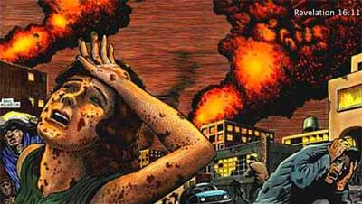
Biblical Repentance
“And they did not repent of their murders or their sorceries or their sexual immorality or their thefts.” (Revelation 9:20-21)

Slide 55
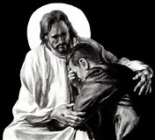
Biblical Repentance
Repentance and
Confession of Sins

Slide 56
Biblical Repentance
Repentance is not a condition for eternal life.
Repentance is not a condition for fellowship with God, but confession of sins.

Slide 57
Biblical Repentance
Confession of sins occurs as we “walk in the Light” (1 John 1:7) living under the teaching and instruction of the Word of God.

Slide 58
Biblical Repentance
When the Light exposes sin in our lives we are to then confess them (1 John 1:9), and receive the forgiveness of sins.

Slide 59
Biblical Repentance
1 John is written to mature believers who are already in fellowship with God, and how to maintain that fellowship is confession of sins, not repentance.

Slide 60
Biblical Repentance
Conclusion

Slide 61
Biblical Repentance
Repentance is turning from sins, in order to avoid temporal punishment, the Wrath of God, the natural consequences of on going sin in our lives, for anyone who is not walking in the Light.

Slide 62
Biblical Repentance
Repentance can save a life from premature death.
Repentance, if necessary, can restore a believer’s lost fellowship with the LORD.

Slide 63
Biblical Repentance
Repentance can help lead an unbelieve to faith in Christ.
Repentance can help an unbeliever turn from his sinful ways because they will ruining his life.

Slide 64
Biblical Repentance
We can encourage an unbeliever to repent in order to be saved from the power of sin, and believe in Jesus for eternal life in order to be saved from the penalty of eternal separation from God, just make them distinct.

